Slide 1
UNIT – V:
Expert Systems: Representing and using domain knowledge, expert system shells, and knowledge acquisition.

Slide 2
SYLLABUS
UNIT – V
Expert System:
Representing and using Domain Knowledge,
Reasoning with knowledge,
Expert System Shells-examples,
Knowledge acquisition skills-examples.

Slide 3
What is an Expert System?
An expert system is a computer program that is designed to solve complex problems and to provide decision-making ability like a human expert.
It performs this by extracting knowledge from its knowledge base
using the reasoning and inference rules according to the user queries.
The expert system is a part of AI, and the first ES was developed in the year 1970, which was the first successful approach of artificial intelligence.
It solves the most complex issue as an expert by extracting the knowledge stored in its knowledge base.

Slide 4
The system helps in decision making for complex problems using both facts and heuristics like a human expert.
The performance of an expert system is based on the expert's knowledge stored in its knowledge base.
The more knowledge stored in the KB, the more that system improves its performance.
One of the common examples of an ES is a suggestion of spelling errors while typing in the Google search box.

Slide 5
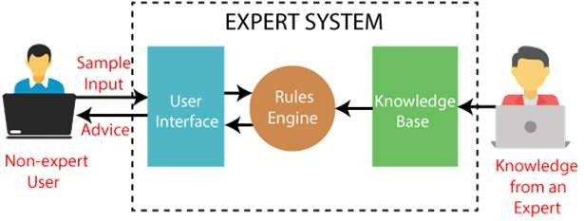
Block diagram that represents the working of an expert system:
Note: It is important to remember that an expert system is not used to replace the human experts; instead, it is used to assist the human in making a complex decision

Slide 6
Below are some popular examples of the Expert System:
DENDRAL: It was an artificial intelligence project that was made as a chemical analysis expert system. It was used in organic chemistry to detect unknown organic molecules with the help of their mass spectra and knowledge base of chemistry.
MYCIN: It was one of the earliest backward chaining expert systems that was designed to find the bacteria causing infections like bacteraemia and meningitis. It was also used for the recommendation of antibiotics and the diagnosis of blood clotting diseases.
PXDES: It is an expert system that is used to determine the type and level of lung cancer. To determine the disease, it takes a picture from the upper body, which looks like the shadow. This shadow identifies the type and degree of harm.
CaDeT: The CaDet expert system is a diagnostic support system that can detect cancer at
early stages.

Slide 7
Characteristics of Expert System
High Performance: The expert system provides high performance for solving any type
of complex problem of a specific domain with high efficiency and accuracy.
Understandable: It responds in a way that can be easily understandable by the user. It
can take input in human language and provides the output in the same way.
Reliable: It is much reliable for generating an efficient and accurate output.
Highly responsive: ES provides the result for any complex query within a very short
period of time.

Slide 8
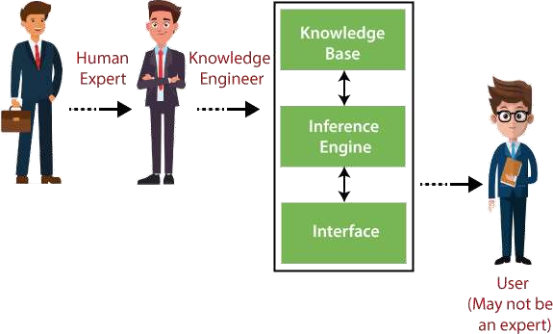
Components of Expert System
An expert system mainly consists of three components:
User Interface
Inference Engine
Knowledge Base

Slide 9
1. User Interface
With the help of a user interface, the expert system interacts with the user, takes queries as an input in a readable format, and passes it to the inference engine.
After getting the response from the inference engine, it displays the output to the user.

Slide 10
2. Inference Engine(Rules of Engine)
With the help of an inference engine, the system extracts the knowledge from the
knowledge base.
There are two types of inference engine:
Deterministic Inference engine: The conclusions drawn from this type of inference
engine are assumed to be true. It is based on facts and rules.
Probabilistic Inference engine: This type of inference engine contains uncertainty in
conclusions, and based on the probability.

Slide 11
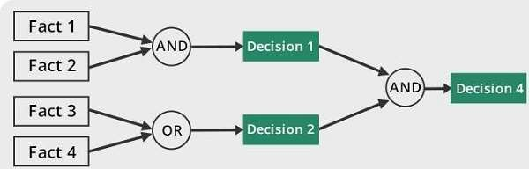
Inference engine uses the below modes to derive the solutions:
Forward Chaining: It starts from the known facts and rules, and applies the inference
rules to add their conclusion to the known facts.
For example, prediction of share market status as an effect of changes in interest rates.

Slide 12
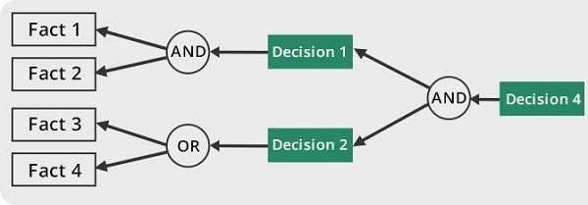
Backward Chaining:
It is a backward reasoning method that starts from the goal and works backward to
prove the known facts.
For example, diagnosis of blood cancer in humans.

Slide 13
3. Knowledge Base
The knowledgebase is a type of storage that stores knowledge acquired from the different experts of the particular domain.
It is considered as big storage of knowledge. The more the knowledge base, the more precise will be the Expert System.

Slide 14
Components of Knowledge Base
Factual Knowledge: The knowledge which is based on facts and accepted by
knowledge engineers comes under factual knowledge.
Heuristic Knowledge: This knowledge is based on practice, the ability to guess,
evaluation, and experiences.
Knowledge Representation: It is used to formalize the knowledge stored in the knowledge base using the If-else rules.
Knowledge Acquisitions: It is the process of extracting, organizing, and structuring the domain knowledge, specifying the rules to acquire the knowledge from various experts, and store that knowledge into the knowledge base.

Slide 15
Participants in the development of Expert System
There are three primary participants in the building of Expert System:
Expert: The success of an ES much depends on the knowledge provided by human experts. These experts are those persons who are specialized in that specific domain.
Knowledge Engineer: Knowledge engineer is the person who gathers the knowledge from the domain experts and then codifies that knowledge to the system according to the formalism.
End-User: This is a particular person or a group of people who may not be experts, and working on the expert system needs the solution or advice for his queries, which are complex.

Slide 16
Advantages of Expert System
These systems are highly reproducible.
They can be used for risky places where the human presence is not safe.
Error possibilities are less if the KB contains correct knowledge.
The performance of these systems remains steady as it is not affected by emotions,
tension, or fatigue.
They provide a very high speed to respond to a particular query.

Slide 17
Limitations of Expert System
The response of the expert system may get wrong if the knowledge base contains the
wrong information.
Like a human being, it cannot produce a creative output for different scenarios.
Its maintenance and development costs are very high.
Knowledge acquisition for designing is much difficult.
For each domain, we require a specific ES, which is one of the big limitations.
It cannot learn from itself and hence requires manual updates.

Slide 18
Applications of Expert System
In designing and manufacturing domain
It can be broadly used for designing and manufacturing physical devices such as camera lenses and automobiles.
In the knowledge domain
These systems are primarily used for publishing the relevant knowledge to the users. The two popular ES
used for this domain is an advisor and a tax advisor.
In the finance domain
In the finance industries, it is used to detect any type of possible fraud, suspicious activity, and advise
bankers that if they should provide loans for business or not.
In the diagnosis and troubleshooting of devices
In medical diagnosis, the ES system is used, and it was the first area where these systems were used.
Planning and Scheduling
The expert systems can also be used for planning and scheduling some particular tasks for achieving the
goal of that task.

Slide 19
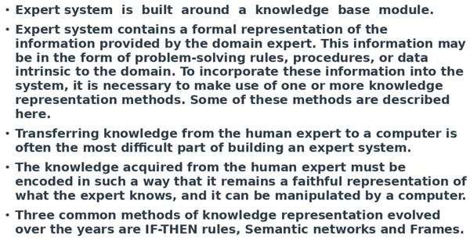
Representing and using Domain Knowledge

Slide 20
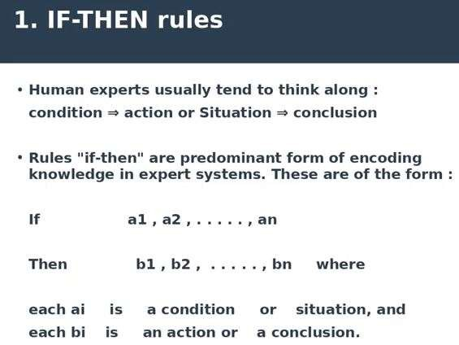

Slide 21
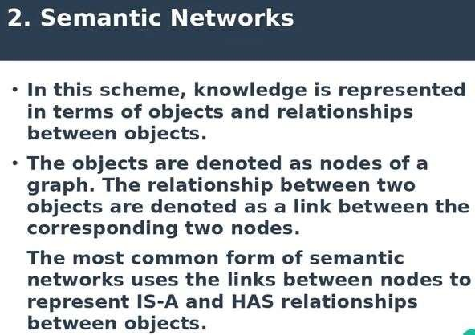

Slide 22
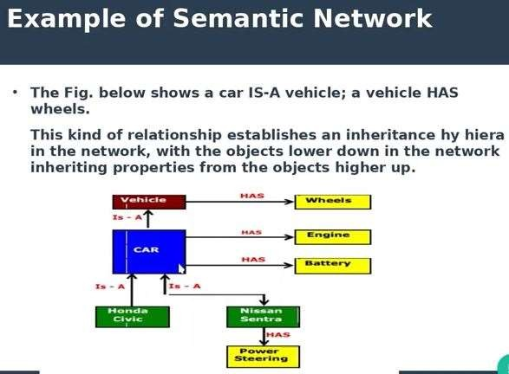

Slide 23
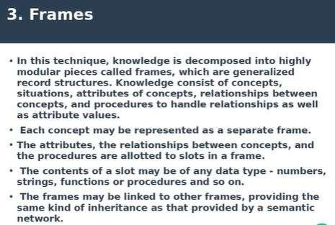

Slide 24
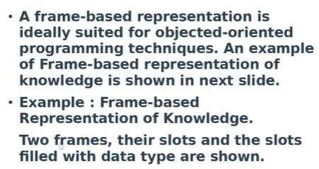

Slide 25
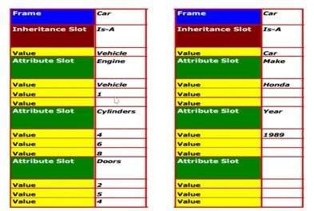

Slide 26
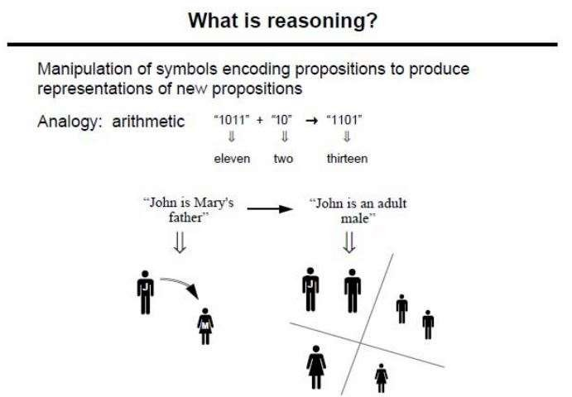
Reasoning with Knowledge
To help machines perform human-level functions, artificial intelligence and its various subfields
like machine learning, deep learning, natural language processing, and more rely on reasoning and
knowledge representation.
Reasoning in artificial intelligence helps machines think rationally and perform functions like humans.

Slide 27
EXAMPLE OF REASONING IN ARTIFICIAL INTELLIGENCE
To better understand how reasoning works in artificial intelligence applications and
systems, let us consider two such examples:
Siri: The cognitive virtual assistant uses reasoning to offer suggestions and recommendations based on commands. For example, the nearest location, the date for tomorrow, AM and PM, among other things.
WolframAlpha: This computational knowledge engine relies on reasoning to perform
mathematical computations based on portions of food.
In short, like humans, machines use reasoning, along with knowledge representation,
logic, and learning for analysis, problem-solving, making conclusions, and more

Slide 28
TYPES OF REASONING IN ARTIFICIAL INTELLIGENCE:
In artificial intelligence, there are different types of reasoning, each of which is focused on
inferring facts from the existing data. These are:
Deductive Reasoning: A type of propositional logic in artificial intelligence, deductive reasoning is a formal method of top-down logic that requires various rules and facts, called premises, to deduce the conclusion is right. This concept of deductive reasoning is expressed visually in the form of a funnel that narrows a general idea into the final conclusion. In short, deductive reasoning uses formal logic to produce logically certain results, using a set process, which involves the following steps.
  Theory
  Hypothesis
  Patterns
  Confirmation

Slide 29
Inductive Reasoning: An opposite of deductive reasoning, inductive reasoning is a bottom-up logic that uses specific observations to reach a conclusion. Used in cases where there is a limited set of facts and data to arrive at a conclusion, Inductive reasoning uses historical data to produce a generic rule whose conclusion is supported by the premises. Also known as cause-effect reasoning, this second type of reasoning is exploratory in nature and allows for uncertain but likely results.
Like Deductive reasoning, inductive reasoning also follows a set of steps to perform reasoning, these are:
  Observation
  Pattern
  Hypothesis
  Theory

Slide 30
Abductive Reasoning: An extension of deductive reasoning, abductive reasoning, is a form of logical inference that seeks theories to define observations using the simplest and likely explanation. Compared to inductive reasoning, abductive reasoning, which is also known as abductive inference or retroduction, is less rigorous and allows for most accurate suggestions and guesses. However, unlike deductive reasoning, it does not rectify the plausible conclusion and is mostly used in data certainties. It is associated with troubleshooting and decision making.
Commonsense Reasoning: A type of informal reasoning, commonsense reasoning in artificial intelligence helps machines simulate human ability to make decisions and perceptions about real-world events. Operating on heuristic knowledge and rules, common sense in AI relies on accurate judgment rather than logic and is gained through experience. It is mainly used in computer vision and robotic manipulation.

Slide 31
Monotonic Reasoning: Another important reasoning type, monotonic reasoning uses available information and facts to reach a conclusion, which remains the same even after new information is added to the existing one in the knowledge base. Since it does not modify the conclusion based on the new data, it cannot be used in systems that require real-time inputs and outputs. Monotonic reasoning is used in conventional reasoning systems and logic-based systems.
Non-monotonic Reasoning: Unlike Monotonic Reasoning, in non-monotonic reasoning, the conclusion is termed as invalid if new or more information is added to the knowledge base. It is mostly used to capture and represent defeasible or invalidated inferences and defaults. Moreover, this type of reasoning deals with uncertain and incomplete models.
Forward & Backward Reasoning: Apart from these reasoning types, Forward and Backward Reasoning in artificial intelligence are two more commonly used inference and reasoning techniques that help machines perform reasoning like humans and reach the conclusion or solutions, with great accuracy and speed. These are mostly used in expert systems, game theory, general-purpose inference engines, and more.

Slide 32
Expert System Shells
Initially Expert system was created from scratch, usually in LISP
The systems were constructed as set of rules combined with an interpreter for all those representations.
After several systems developed, It was clear these systems often had a lot in common. So it was possible to separate interpreter and domain specific knowledge.
The resulting interpreter is shells .we can create new expert system by adding new knowledge.
These shells provide flexibility in representing knowledge and in reasoning.
Each shell provided mechanism for knowledge representation, reasoning and explanation

Slide 33
Expert System Shells
An expert system shell can be considered as a expert system with the flexibility to change the knowledge. Therefore, all the user has to do is to add the knowledge in the form of rules and provide relevant data to solve a problem.
An Expert system shell is a software development environment. It contains the basic components of expert systems. A shell is associated with a prescribed method for building applications by configuring and instantiating these components.
Shell components and description
The generic components of a shell : the knowledge acquisition, the knowledge Base, the reasoning, the explanation and the user interface are shown below. The knowledge base and reasoning engine are the core components.

Slide 34
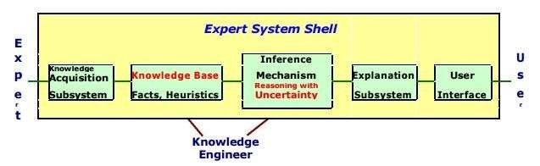
All these components are described as.
Knowledge Base
A store of factual and heuristic knowledge. Expert system tool provides one or more knowledge representation schemes for expressing knowledge about the application domain. Some tools use both Frames (objects) and IF-THEN rules. In PROLOG the knowledge is represented as logical statements.

Slide 35
Reasoning Engine
Inference mechanisms for manipulating the symbolic information and knowledge in the knowledge base form a line of reasoning in solving a problem. The inference mechanism can range from simple modus ponens backward chaining of IF-THEN rules to Case-Based reasoning.
Knowledge Acquisition subsystem
A subsystem to help experts in build knowledge bases. However, collecting knowledge, needed to solve problems and build the knowledge base, is the biggest bottleneck in building expert systems.

Slide 36
Explanation subsystem
A subsystem that explains the system's actions. The explanation can range from how the final or intermediate solutions were arrived at justifying the need for additional data.
User Interface
A means of communication with the user. The user interface is generally not a part of the expert system technology. It was not given much attention in the past. However, the user interface can make a critical difference in the perceived utility of an Expert system.

Slide 37
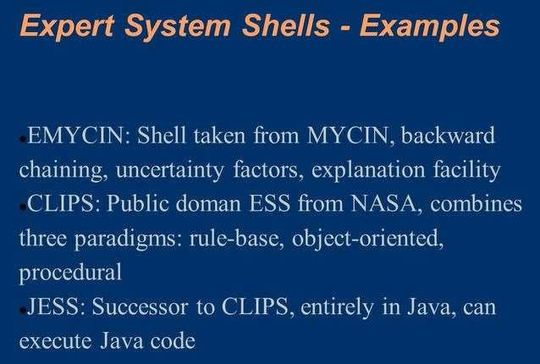

Slide 38
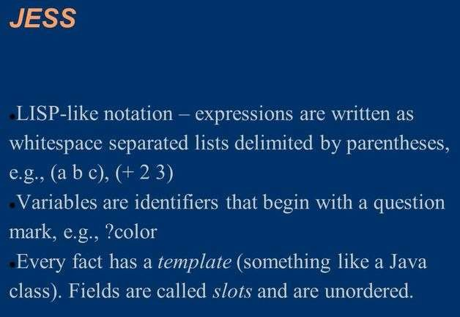

Slide 39
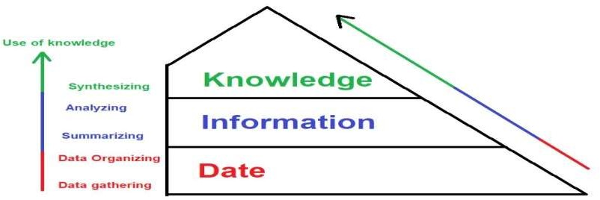
Knowledge acquisition
Knowledge acquisition can be defined as the situation in which the organization and individuals obtain the required knowledge that helps them accomplish their work efficiently, easily, and at the lowest possible cost.
Steps of knowledge acquisition process

Slide 40
1. Data gathering
Data gathering is the first step in knowledge acquiring.
First, you to determine what data will be collected, how, and where this data is located. In other words, planning before anything else.
Determining the type of data required and the accuracy and correctness of this data significantly affect the quality and accuracy of the knowledge. Therefore, You should implement this step well.

Slide 41
2. Data Organizing
In the previous step, the data state is often not well organized. Therefore, the knowledge management team must rearrange the data to obtain valuable information from it in this step.
For example, the data with a relationship are collected in one place, like collecting customer data from a specific geographic area. Collecting data for each age group of customers together, and so on.
3. Summarizing
In this step, various statistics are extracted from databases. These statistics are
presented in tables and graphs in multiple forms.
It should be noted here that upon completion of this step, the raw data has been converted into information that can be used further.

Slide 42
4. Analyzing
The information is analyzed, looking for recurring patterns that can be considered a new characteristic or a new knowledge.
For example, you might find that a particular age group of customers is interested in a specific product.
For example, you can get a result that people between the ages of 8-28 are interested in buying video games.
Another example, you notice that in a particular geographic region, the majority of customers are women. And so on.

Slide 43
5. Synthesizing
This step depends on joining statistics and patterns and coming out of them with fixed concepts that can be relied upon. These concepts are the knowledge you are looking for.
Knowledge management stores these results in rules or laws in the organization’s knowledge databases. So that everyone who wants it can reach it.
After this stage, knowledge management completes other knowledge management
processes such as storing and distributing knowledge.

Slide 44
Knowledge acquisition example
Retail store company
In the first phase, the company will open stores and branches in a variety of geographical
locations.
The daily selling process generates an enormous amount of data. This information contains all customer data related to their purchases. This data also includes credit card information. You can consider this stage as the stage of data collection.
In addition, the organization’s knowledge management team can receive data from external
sources about customers, weather conditions, laws, information about competitors, etc.
In the second step, its knowledge management department receives this data, arranges it in databases, and coordinates groups to facilitate its use.
The company is extracting statistics and graphs for the various products sold, such as the
n.umber of dairy and meat products, sales of electronic devices, etc.

Slide 45
Also, the reports are classified according to customers’ age, gender, income level, etc. This is to obtain an extensive view of the company’s products and customers.
By analyzing and compiling reports and statistics, the company noticed some patterns and similarities in customers’ behavior. The patterns are so frequent that they can be taken as a general rule. Examples of these patterns include:
Most of the customers who buy nappies buy wet towels with them.
Dairy products in the store in the geographical location Y are not sold in the same quantities compared to other stores
The store located in the geographical location Q sells more than 50% of the baby products from the rest of the branches.
As a result, the knowledge that the company has acquired using the knowledge acquisition process explained earlier. Now the company can rely on this knowledge to make appropriate decisions.

Slide 46
THANK YOU

